Slide 1


Slide 2

Listening is the most important communication skill
We probably spend more time using our Listening Skills than any other kind of skill
Like other skills, Listening takes practice
Real Listening is an active process
Listening requires attention

Slide 3

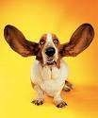
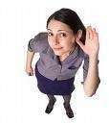
Effective Listening is the process of analyzing sounds, organizing them into recognizable patterns, interpreting the patterns and understanding the message by inferring the meaning
Many of the problems we experience with people in our daily lives are primarily attributable to ineffective listening or lack of listening

Slide 4
The First and the foremost communication skill that we learn in our lives is nothing but “LISTENING”
LISTENING
SPEAKING
READING
WRITING

Slide 5
Fallacies about Listening
Listening is not my problem!
Listening and hearing are the same
Good readers are good listeners
Smarter people are better listeners
Listening improves with age
Listening skills are difficult to learn

Slide 6



















To learn
To increase one’s understanding
To advise or counsel
To relieve one’s boredom (listening to music)

Slide 7
Communication is not complete without effective listening
An attentive listener stimulates better speaking by the speaker
A good listener learns more than an indifferent listener
A good listener can restructure vague speaking in a way that produces clearer meaning
A good listener learns to detect prejudices,assumptions and attitudes
10

Slide 8



The receiver receives the sounds
The receiver recognizes them
The receiver understands them
The receiver interprets them in the context
The receiver derives the meaning
The receiver responds to the message

Slide 9















DISCRIMINATIVE LISTENING
When the listener discriminates the sounds while listening, it is called discriminative listening.
It is the first stage of listening.
It is all about distinguishing between sounds and individual words.
A person recognizes the sounds and identifies the speaker.
This is easier when one uses mother tougue.

Slide 10
COMPREHENSIVE LISTENING
When the listener comprehends the message while listening, it is called comprehensive listening.
The primary purpose of this listening is to understand the message which is sent by the sender.
It is also called the second stage of listening.
Good vocablary, understanding of grammar and syntax as well as body language of a speaker and concentration are important factors for successful comprehensive listening.
It is also known as ‘Content’ or ‘Informative’ listening

Slide 11
EMPATHETIC LISTENING
Empathy means to go beyond the sympathy.
it is to feel what the speaker has gone through and is sharing.
In this listening, the listener enters into the world of the speaker and sees,feels and hears what the speaker sees,feels and hears.
The purpose of this listening is to help the speaker to get healed, learn and develop.
For empathetic listening, the listener should have understaning of para language and non verbal signals.
This type of listening is curative in nature so it is also known as ‘ therapeutic’ listening.

Slide 12
APPRECIATIVE LISTENING
The objective of this type of listening is to enjoy whatgever one is listening.
When someone is watching a movie, a play or a T.V show and is enjoying the process, We can say that he or she is doing appreciative listening.
Previous experience and taste play an important role in this listening.
It requires liking, understanding and taste for the particular thing.
Sometimes, that is enjoyed by the one listener may not be enjoyed by the other.

Slide 13
CRITICAL LISTENING
When the listener forms an opinion or a judgement by evaluating the message, it is called Critical listening.
The listener is expected to reply critically while giving feedback.
It is essential for decision making.
It is used when the listener needs to verify whether the speaker is speaking truth or not.
It is also known as Interpretative or Evaluative or Judgemental listening.

Slide 14
ETHOS, LOGOS AND PATHOS
According to Aristotle, there are three important things for an effective critical listening. They are Ethos. Logos and Pathos.
ETHOS
It is concerned with reliability,sincerity and trustworthiness of a speaker.
While listening to a person, one needs to confirm the credibility of a speaker.
The listener will show positive behaviour if the speaker is found credible.
Credibility depends on two things- Expertise and Trustworthiness.

Slide 15
LOGOS
Logical arguements of thoughts are known as Logos.
A critical listener expects logically organized thoughts and well constructed arguements from the speaker.
PATHOS
The speaker would try to appeal to emotions or psychology of the listener.
The speaker may target either the spirit of adventure, need for safety, feeling of guilt, desire for power,quality of being generous or ability for creativity of the listener.

Slide 16




























In communication, all the sent messages are not always the received messages. In other words, it does not happen all the time that the message are received in the same spirit and meaning with which they were sent.
They are divided into three catagories:
1. Barriers caused by the Speaker
2. Barriers caused by the Listener
3.Barriers caused by the Environment

Slide 17
BARRIERS CAUSED BY THE SPEAKER
Boring speaker
Uninteresting message
Incomprehensible message
Unorganized speech
Monotonous delivery

Slide 18
BARRIERS CAUSED BY THE LISTENER
Believing more knowledgeable than the speaker
Being pre-occupied with something else than the speech
Not having necessary vocabulary
Having selective listening
Formulating reply while listening

Slide 19
Keeping the television on while talking to someone
Paying more attention to the speaker than the speech
Focusing on other things like things happening outside the window and people sitting around
Having no interest in the speech or ‘Mr Know All’ attitude

Slide 20
Doing the things like playing with a pen, arranging hair, reading or sending messages etc
Excessive feeling of love or hatred, excitement or anxiousness, stress or happiness
Listening without understanding the cultural differences
Experiencing physical discomfort like hunger,thirst, need to use washroom etc

Slide 21
BARRIERS CAUSED BY THE ENVIRONMENT
Noise of vehicles, marriage procession passing by etc
Buzzing among the audience
Effect of seasons
Uncomfortable or inappropriate seating arrangement

Slide 22
TRAITS OF A GOOD LISTENER
Looks for the idea being presented
Listens with a mind and not overcome by emotions
Concentrates on what the speaker says
Understands and accepts the speaker’s point of view
Note downs the points he or she disagrees to and queries later on
Reflects on the content of the speaker and summarizes the main points

Slide 23
TRAITS OF A GOOD LISTENER
Listens with receptive mind
While listening to an elderly person repeating stories, doing pseudo listening
Gives constructive feedback
Maintains a comfortable eye contact
Gives vocalized clues like ‘ I see’, ‘ I agree with you’, ‘It is a good idea’ etc

Slide 26
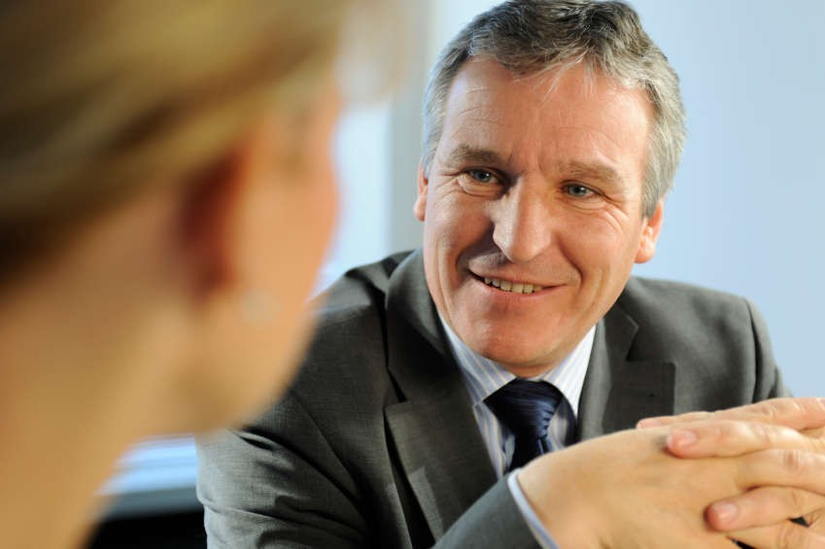

Slide 27






